Slide 1
Personal Statement Workshop: How to Write About Your Identities
Chemistry CARES Committee
October 6, 2023
12:00 - 2:00 PM
Tech K140

Slide 2
Workshop Questions Overview
When should you write about your identity in an application?
How can you start to think about your identities?
How can you write about your identities and experiences in a meaningful way to convey the message you want?

Slide 3
When to Write About Your Identity
Different applications call for a “DEI” statement or “Personal” Statement
NSFGRFP
Personal Statement, particularly “Broader Impacts” section
Grad School Applications
Personal Statement
DEI Statement
Whether you know it or not, you are actually always communicating some part of your identity in your writing, whether implicitly or explicitly

Slide 4
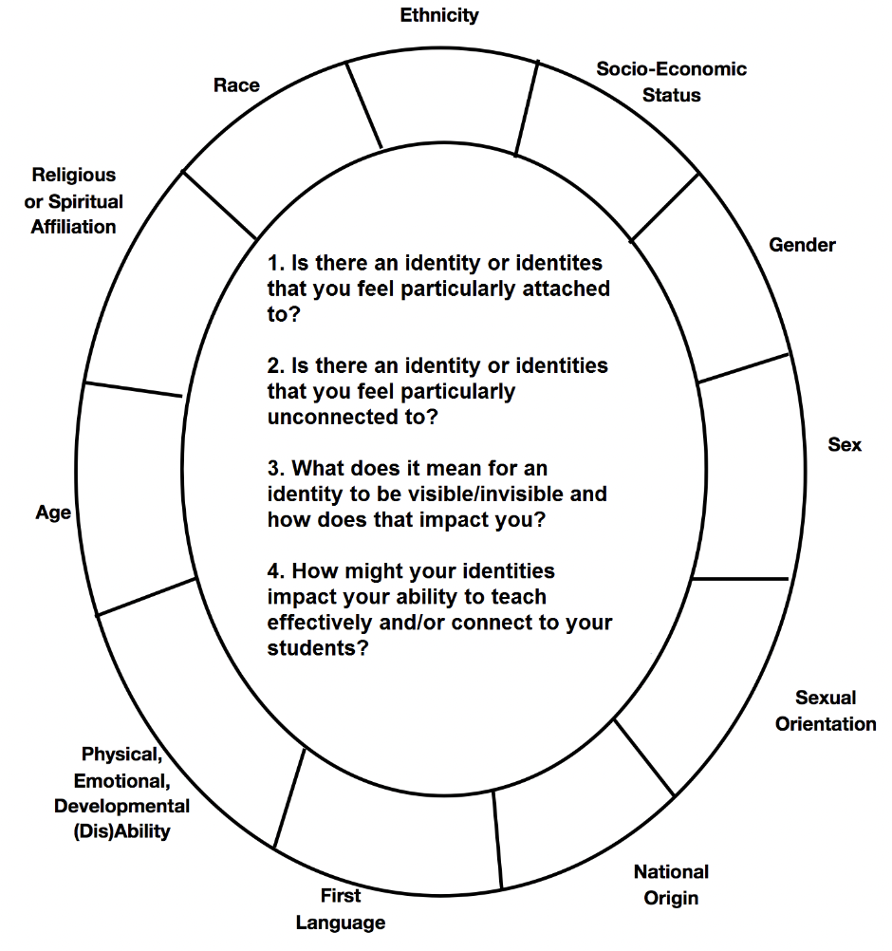
Identity Wheel Activity
Fill out the wheel to the best of your ability (both blank spaces and answering the questions)
Think about how holding that identity/those identities impacted how you interact with the world, especially with other people & chemistry → write down some of these thoughts

Slide 5
Identity Wheel Activity Example (Informal)
I (Clover) am Romanian. My parents immigrated to the US from Romania before I was born, but my first language was Romanian, and my parents still speak it. My mom sometimes has trouble with English and I have had to explain things in a different way, or try to come up with different words to express the same thing. I think that’s part of why I like to and am good at explaining concepts in chemistry in different ways.

Slide 6
Identity & Impact Reflection Questions
How does science impact social change?
In what ways will your scientific work positively impact the field (or the world) with respect to diversity, inclusion, and social justice?
Impact on climate? Access to food or energy? Clean water? Most of these have implications on broader equity–you just have to make the connection explicit.

Slide 7
How do we make our personal statements genuine and stand out?
Be specific and detailed with any examples you write about
Include initiatives or events that you helped create or run
Don’t try to overdo it; only include the parts of your identity/the experiences that mean the most to you or have truly impacted how you carry yourself

Slide 8
Anonymous Excerpt Highlights
… This past September, I was appointed to serve a year-term on the CMNS (College of Mathematics and Natural Sciences) Diversity & Inclusion Advisory Council as one of four undergraduate student members. As a member of the council, I participate in biweekly meetings where I am able to voice student ideas and listen to other council members, which include graduate students, staff, professors, and department chairs. We recently discussed concerns encompassing equity and inclusion for various genders, races, and disabilities. In particular, we would like to administer campus climate assessments, improve diversity in recruitment, and plan activities that foster a more inclusive STEM community. Along with being a woman in STEM, I am a second-generation Korean-American and a first generation college student. As a young child, when I was struggling with homework, my parents could not directly help me due to language and educational barriers. Instead, my mother instilled in me a much more valuable trait—that I had to speak up for myself, get help when I need it. This is why I take initiative to ask questions to teachers. Even now, not only am I proactive, I also ask questions on behalf of others. Currently, I enjoy answering students’ questions through my teaching and mentoring experiences. However, pursuing these interests would not have been possible without support from financial grants. Financial stresses create a burden on my education, so I am appreciative of all the scholarship donors who have helped fund my education including my teaching and research opportunities. Being a first-generation college student and from a working class background has opened my eyes, a reminder that I am fortunate to have these opportunities, and wish to share them with others—to promote frugal science and impart this passion for STEM in disadvantaged communities.
Give concrete examples of the kind of DEI work you do/have done
Include your identity, but more importantly, include how your experience with that identity has shaped the way you approach life and/or STEM specifically → this is what makes it a personal statement

Slide 9
Excerpts Handout
NU Grad School: Diversity Statement
NSF GRFP Personal Statement: Broader Impacts
At the time I joined the organization, AXE was run by a senior chemistry major named Anna. She was the first female role model I had in the chemistry world. She showed me the ropes, helped me get into a research lab, and inspired me to volunteer at an event called Expanding Your Horizons (EYH). This event is a one-day conference that aims at sparking young girls’ interests in science and math through hands-on activities. I participated in a pH demonstration, using red cabbage juice as a pH indicator. I will never forget the look of wonder on one girl’s face after the purple juice turned blue when mixed with soap. Perhaps what was more satisfying was seeing her understand the science after I had explained why that color change occurred. This experience made me realize I had the potential to positively impact the STEM education that young girls receive, and I hope to participate in similar events at Northwestern University. I would also love to participate in the Women in Science and Engineering Research (WISER) program at Northwestern University, as I believe that building a close community of women in science is an excellent way to encourage support and growth for all involved.
Serving as head TA was important to me for a reason outside of gaining teaching experience: it afforded me the opportunity to be a role model for students, a role model that I really could have benefitted from having. I am an openly queer, nonbinary chemist: I present androgynously, and I go by the nickname “Clover” to all my students and professors. This might not seem like a huge deal, and to most, it isn’t, but to those few students I have had who are members of the LGBTQ+ community, I know it matters, because I know how much Dr. Tom Ruttledge, the first openly gay chemistry professor I would come to know, mattered to me. He taught me how to be unapologetically, authentically yourself, and inspired me to be open and honest about who I am. However, even though I was able to be a role model for younger students, I found myself struggling to find mentors myself, or even a community among the graduate students at Northwestern. Therefore, I sought out GoSTEM at NU, the graduate student chapter of Out in STEM, an international organization whose mission is to support LGBTQ+ students in STEM fields. To my dismay, the executive board was all but graduated, so I met with the advisor and outgoing president and decided to take on the role of president myself. With the help of a few new board members, I was able to organize a social event during Pride Month this past academic year, where over 40 graduate students across multiple departments came together to learn about the goals of GoSTEM. One initiative I am particularly excited about is the Buddy Program I will enact with the undergraduate chapter of Out in STEM at NU. By pairing undergraduate students with graduate student mentors with whom they identify on a personal level, both groups of people will benefit: the undergraduates will have mentors that can provide guidance and support, and the graduate students will get the opportunity to give back and learn how to be an effective mentor. I will build on the work that the previous executive board of GoSTEM has done and put together a community of LGBTQ+ STEM graduate students at Northwestern that will be able to support one another, both personally and professionally.

Slide 10
Examples of Statements
Read the sample statements from your handout and pick out notable elements to discuss
Things to think about:
What did you notice worked well?
What surprised you? Was there something you wouldn’t have thought to include?
Do you have specific follow-up questions about after reading the examples?

Slide 11
Tips for Writing an Outline
If you’re given a prompt with several questions, write those down and list ideas for each question
This ensures that you will answer every part
Set a timer and write down everything that comes to mind when you think about the prompt
Put all of your thoughts into categories/sections of your essay

Slide 12
Writing Time
Outline a statement for a particular program (NSF, grad school, etc.) that you plan on applying to
Organize that outline
Narrow down what you want to write about
Think of how you want to write about yourself/your goals
Just start typing/writing. Let it flow. You’ll clean it up later.
Once you have a full very rough draft, pause for food :D

Slide 13
Editing Time
Option A: Edit your own essay
Read it forwards to see if the flow makes sense
Read it backwards to help catch spelling/grammar errors
Make a checklist of everything you needed to include based on the essay prompt and/or everything you wanted to include → go through this checklist
Option B: If you are comfortable, swap essays with a partner
Let them know what kind of feedback you are looking for:
Style Feedback: Grammar, spelling, punctuation
Substance Feedback: Flow of content, does the essay answer all the questions of the prompt adequately, is there anything that needs more or less detail, etc.

Slide 14
Good Luck!!! 🍀

